Slide 1
Profiling Homicide Victims (2018-2022) with Insights from the Mexican National Institute of Statistics (INEGI)"
Mortal Mosaic
Mortal Mosaic
Mortal Mosaic
Mortal Mosaic
Mortal Mosaic
Mortal Mosaic
Mortal Mosaic:
Unraveling the Demographics of Homicides in Mexico
Mortal Mosaic
Mortal Mosaic

Slide 2
Table of contents
01
02
Theme
Methodology
03
04
Visualization
Conclusion
Mortal Mosaic
Data Selected and Source
Coding Approach
Mortal Mosaic
Website Overview
Ethical Considerations and Data Limitations
Mortal Mosaic

Slide 3
01. Theme
This project delves into the profiles of homicide victims in Mexico, spanning five years of public data from the INEGI database. Our investigative goal is to unveil the states bearing the brunt of these crimes and to discern the demographic groups most profoundly impacted in terms of gender, age, and educational background.
Our accessible online dashboard delivers a compelling visual portrayal of the harsh realities adversely affecting the country, utilizing insightful statistical charts. By transforming data into vivid narratives, our goal is to enrich comprehension and stimulate informed discussions about the profound societal challenges presented by homicides in Mexico.

Slide 4
02. Methodology
Data Pull
01
05
Web Development
Dowloading public reports from INEGI website
Develop an online-accessible dashboard to showcase comprehensive demographic data
03
Data Processing
02
Data Visualization
04
Interactivity
Augmenting functionality by incorporating supplementary libraries to enhance user-friendly interactions (Highcharts)
Using MongoDB to generate JSON files from data collected
Transforming raw data into a visual format using JavaScript, HTML, and CSS

Slide 5
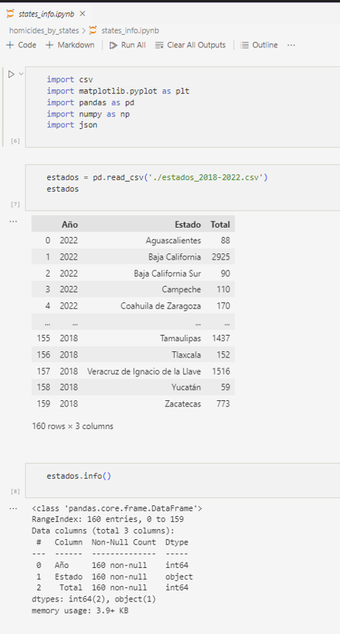
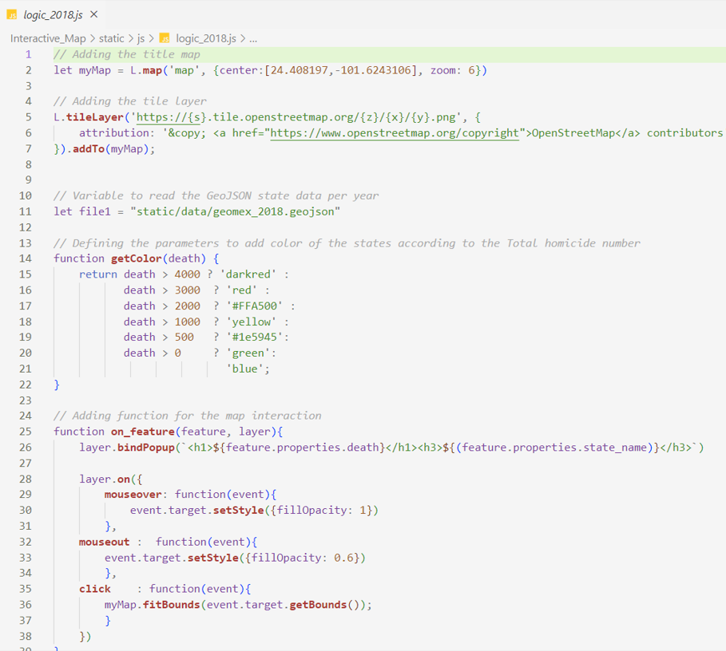
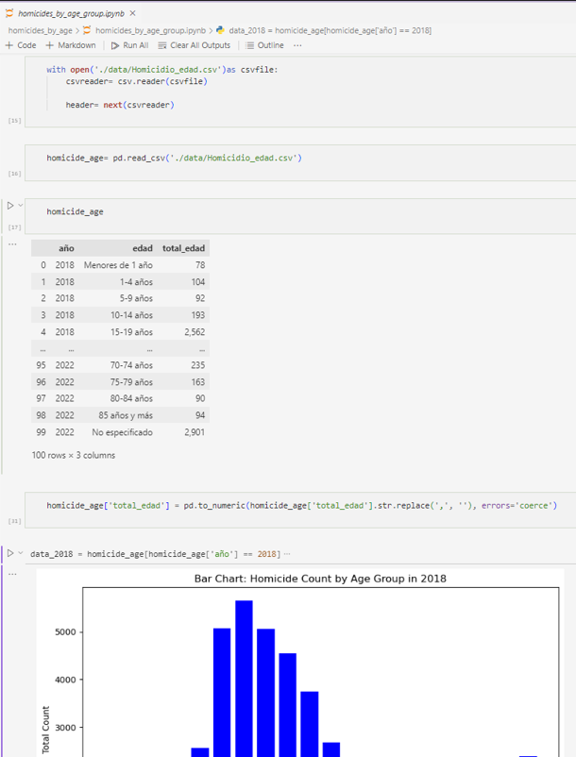
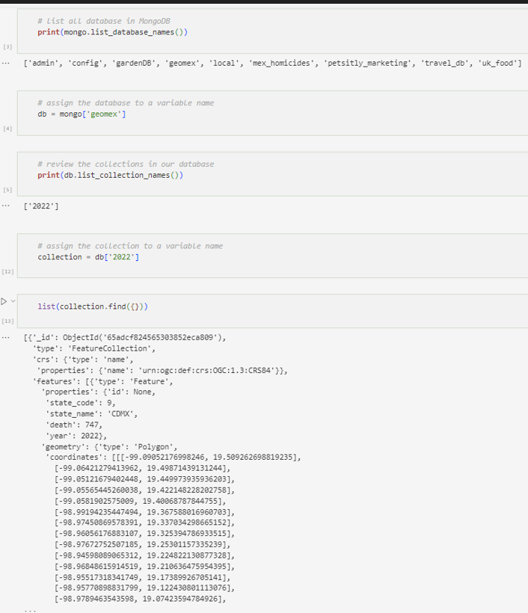
2.1. Data and Coding
Cleaning
Processing
Visualizing

Slide 6
03. Visualization
Incidence Patterns of Homicides Across Age Groups
Frequency of Homicides Based on Gender
Homicides Categorized by the Educational Level of Victims
Exploring the Geographical Dispersion of Analyzed Crimes

Slide 7
04. Conclusion
The data extraction process adhered to ethical standards as all information utilized is publicly available, sourced, and published by the National Institute of Statistics.
Further research is imperative to assess the overall quality of the collected information.
A notable limitation of the dataset is the substantial number of records lacking victim ages, potentially impacting the accuracy of results.
Visualizations highlight a heightened incidence of homicides in the 25-29 age group.
Observation reveals that most homicides affect individuals within the high school and elementary school demographic when examining the broader student population.
The findings indicate a notable disparity in homicide rates between men and women. Throughout the duration of the study, it was consistently observed that over 80% of the victims were male.
Guanajuato, Estado de Mexico and Baja California (North) emerge at the forefront of homicide incidence based on geographic analysis.
Noteworthy consistency in results observed throughout the entire studied period.

